Slide 1

WORLD WIDE WONDERS
Bartsch Liam, Farrell Oisin, Gupta Sanil, Hartshorn Sam, Kaushik Tanmay

Slide 2
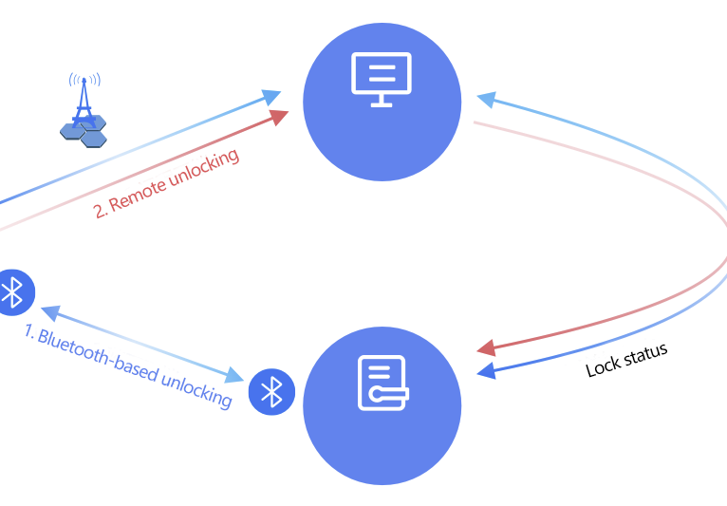
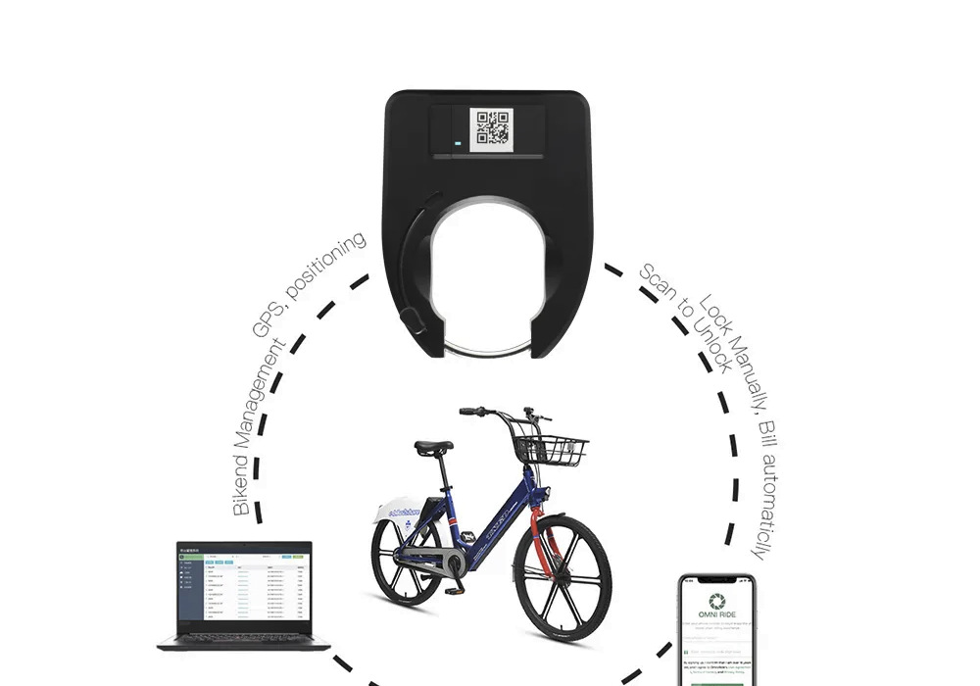
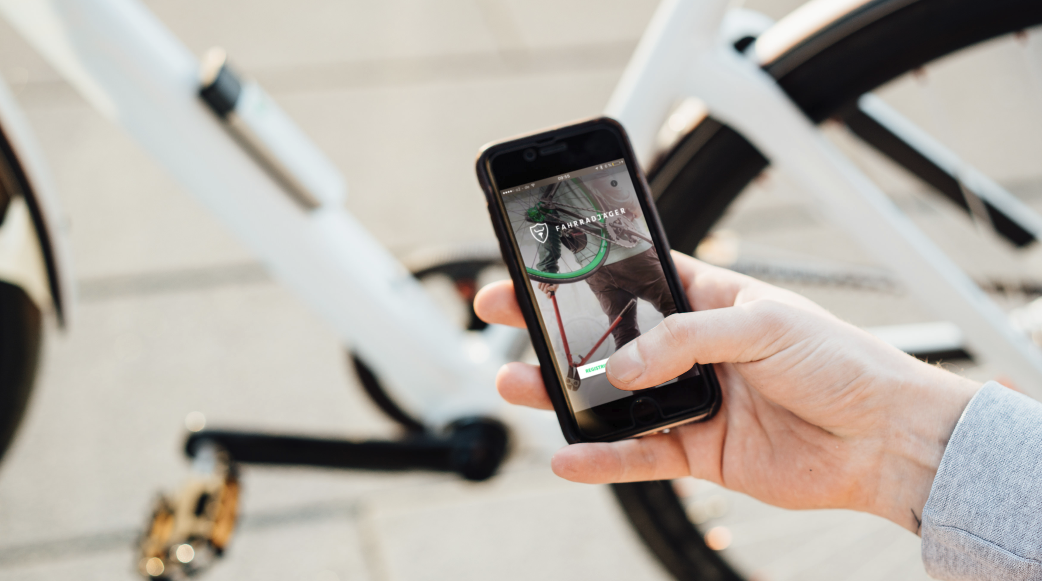
SMART BIKE-LOCK
Lock control via app
Secure authentication
Secure database connection
Safe database storage
Bluetooth Low Energy (BLE) functionality
Theft protection detection
Location tracking

Slide 3
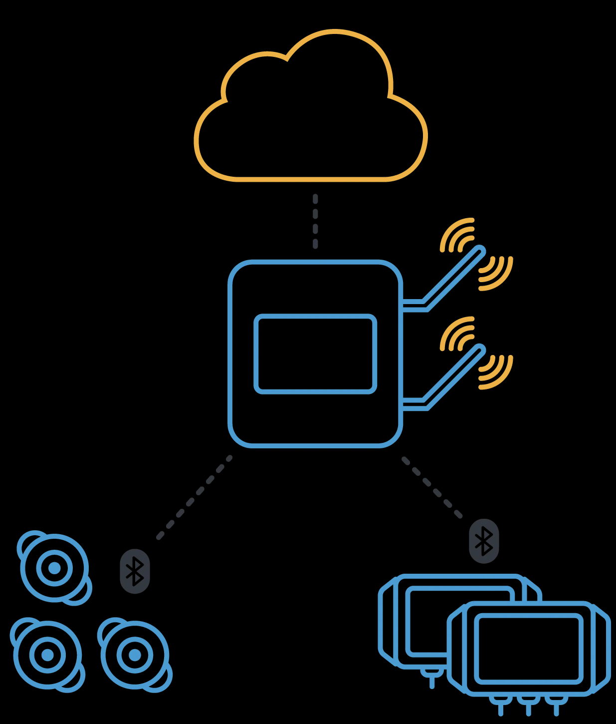
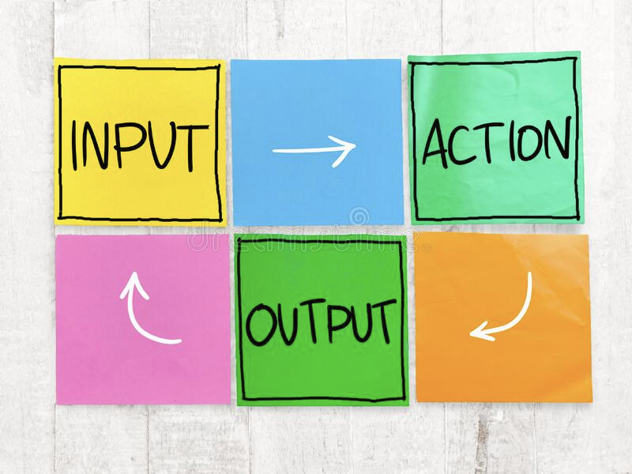

SCALE - IMPLEMENTED SOLUTIONS
Simple modular design
Cheap and affordable
Independent workflow for each node
Small requests
Reliable
Secure
Easy to use

Slide 4

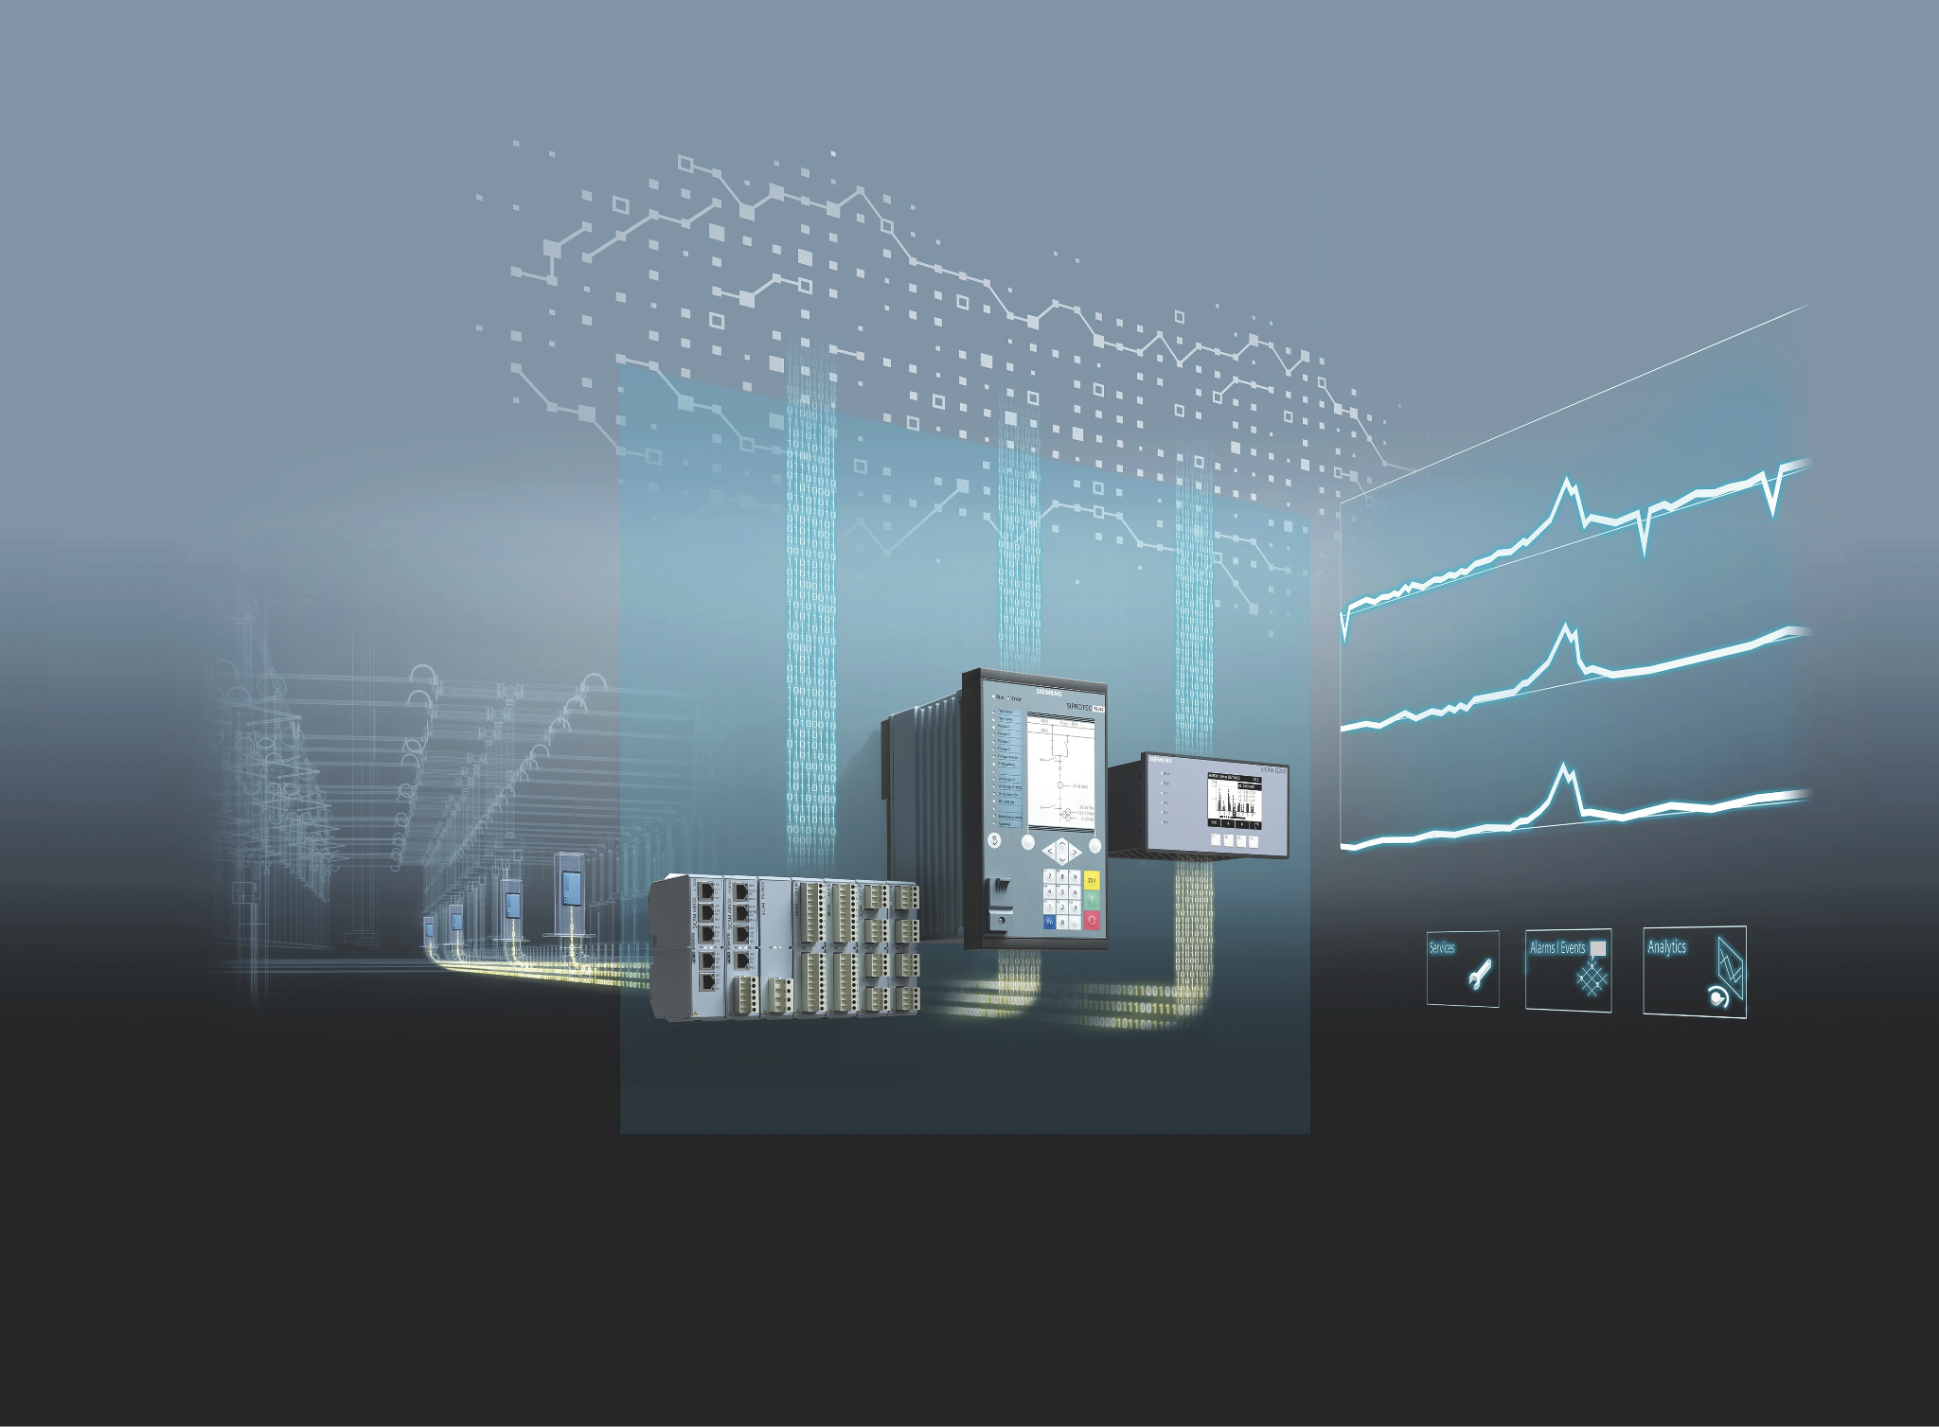
POWER - IMPLEMENTED SOLUTIONS
Rechargeable batteries
Bluetooth Low Energy consumes less power
Optimized code to reduce execution time

Slide 5

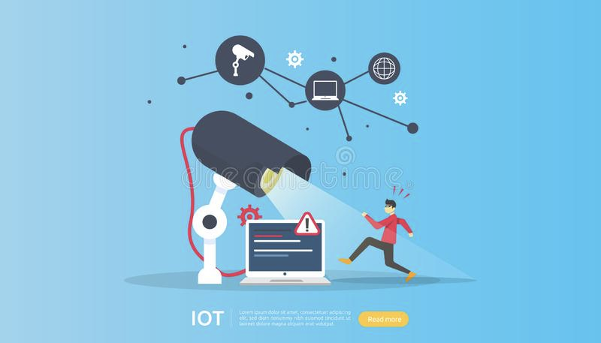
SECURITY - IMPLEMENTED SOLUTIONS
Secure authentication
Stolen state implementation
Speaker alarm (extension)

Slide 6

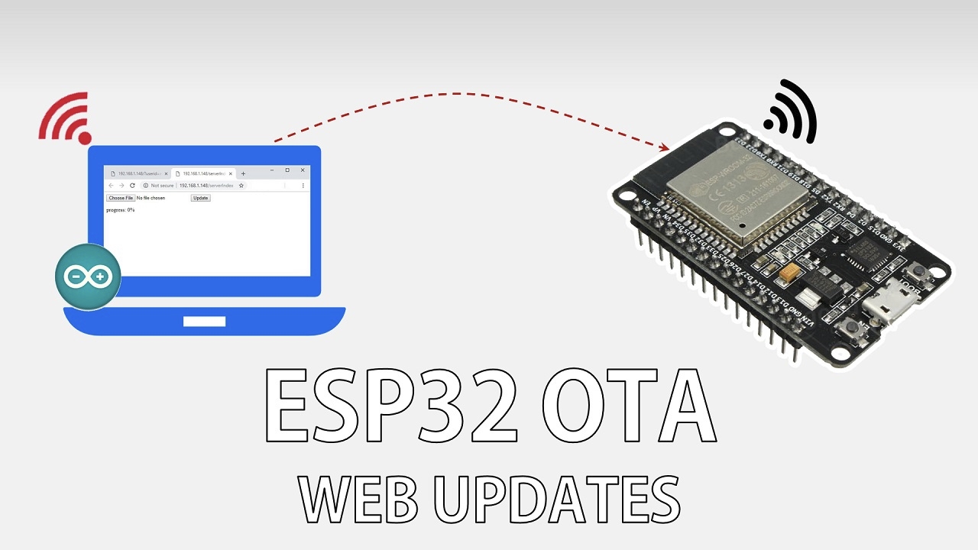
UPDATES – IMPLEMENTED SOLUTIONS
Version control to roll back to previous version
Remote update rollout
Easily update each lock via USB port

Slide 7

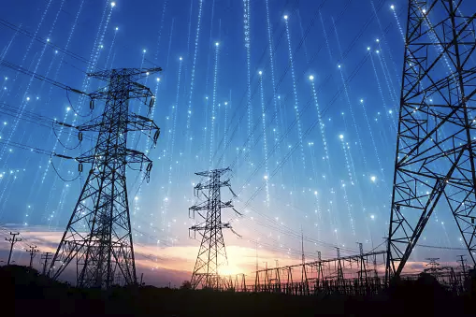
CHALLENGES/PROBLEMS - SOLUTIONS
Problems
Power usage
Connection between database and bike lock
App bugs
ESP32 Memory crashes
GPS issues
Solutions
Use outlet instead of battery
Use library and https to talk with database
Use previous working version (Ideal fix bugs)
Use other ESP32 for bluetooth
Received new GPS that worked

Slide 8
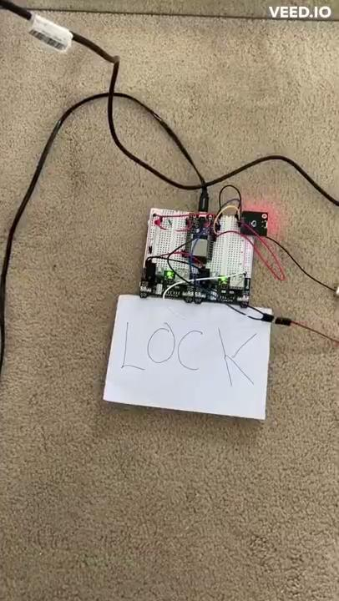
DEMO

Slide 9


REFLECTIONS
A problem is always simpler when broken up into smaller parts
Get the small stuff done first
Properly label commit messages
Create a mini diagram of your wiring

